Slide 1
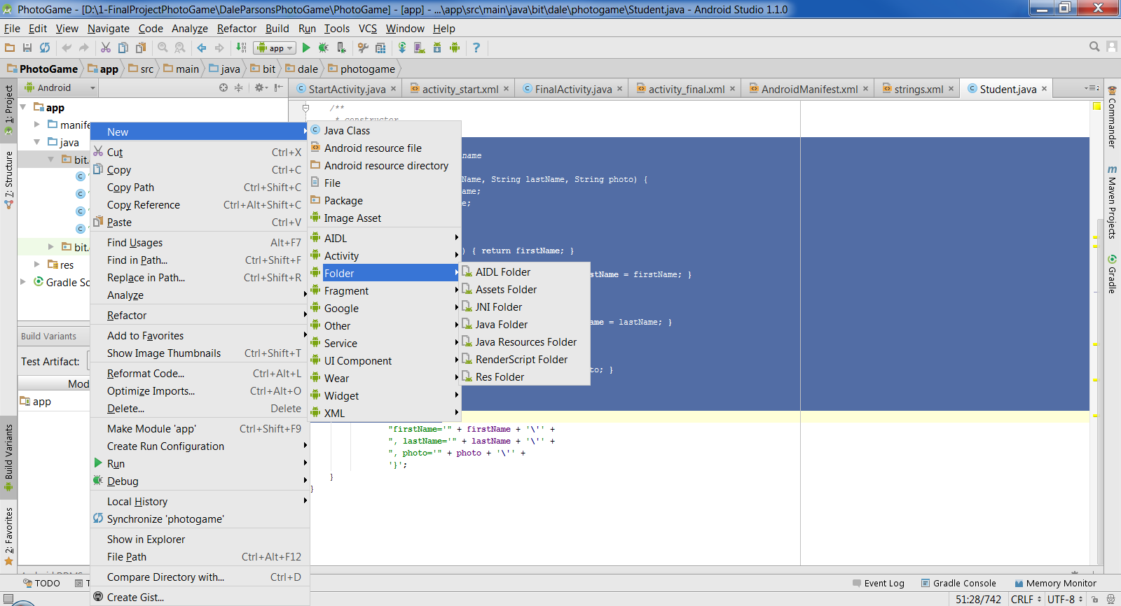
Making the assets folder

Slide 2
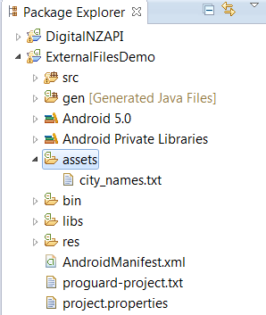
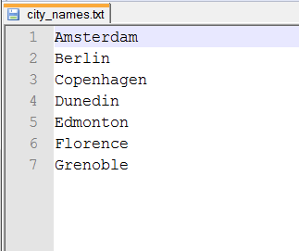
Simple File I/O
Text files are conventionally placed in the ~/assets folder.
Notes:
Often we need to store content for our apps.
For the next example, imagine that we want to store a long list of cities to display in some kind of collection control (perhaps for a hotel reservation or airline bookings app)
We have previously seen that we can store lists of things in res/value as a string array, but when the lists get longer than just a few items, that becomes very tedious, and requires recompilation to modify.
Eventually, we will need to be able to open and read a text file.
NB: In all slides in the powerpoint, try-catch has been removed to save space. For some operations, they are mandatory, and Eclipse will flag you for them.
Text files for input should go in ~/assets
We will start with a simple ascii file containing a list of cities, city_names.txt
Bring it into your project with Import->General->File System
The actual file is shown on the right…It only has seven cities, but the process is identical for 1000s

Slide 3
Simple File I/O
To use files from ~/assets you need an AssetManager
To create a BufferedReader:
Get an InputStream using AssetManager
Use InputStream to create InputStreamReader
Use InputStreamReader to create BufferedReader
Notes:
Shouldn’t be a big surprise by now.
Activities have all kinds of helpers, and get methods to grab them. This is just another one.
To read from an external file, you want to get a BufferedReader. It has the most useful I/O operations.
Getting a BufferedReader is a three-step process.
First you get a system input stream, using the assetmanager
Then you use the inputStream to create an InputStreamReader
Finally you use the InputStreamReader to create a BufferedReader
In code, it looks like this…

Slide 4
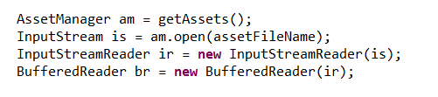
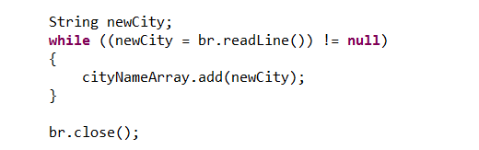
Simple File I/O
Notes:
This code is in my button click handler class for the Fill List button.
Once you have a BufferedReader, you are back in normal I/O stream territory
We have the familiar “loop until readLine returns false” pattern.
cityNameArray is an ArrayList<string> declared as a class field
You now have a nice collection of strings that you can pass off to an ArrayAdapter and put into a ListView…

Slide 5
Difference between /res and /assets directories
Both are pretty similar. The real main difference between the two is that in the res directory each file is given a pre-compiled ID which can be accessed easily through R.id.[res id]. This is useful to quickly and easily access images, sounds, icons...
The assets directory is more like a filesystem and provides more freedom to put any file you would like in there. You then can access each of the files in that system as you would when accessing any file in any file system through Java.

Slide 6
Reading csv files -alternative method
Tutorial reading a csv file
File in the res/raw folder
http://javapapers.com/android/android-read-csv-file/

